Slide 1
CLARIN per le Lingue Antiche
Workshop online
20 marzo 2024
Giulia Pedonese

Slide 2
Sources
This presentation is the result of the adaptation and modification of the following sources:
van der Lek, Iulianna; Fišer, Darja. (2023). Introduction to Language Data: Standards and Repositories. In UPSKILLS Learning Content. https://upskillsproject.eu/project/standards_repositories/. CC BY 4.0.
van der Lek, I., Fišer, D., Samardzic, T., Simonovic, M., Assimakopoulos, S., Bernardini, S., Milicevic Petrovic, M., & Puskas, G. (2023). Integrating research infrastructures into teaching: Recommendations and best practices (Versione 2). Zenodo. https://doi.org/10.5281/zenodo.8114407. CC BY 4.0.
CLARIN ERIC Official Website: https://www.clarin.eu/ . CC BY 2.0

Slide 3
What Is CLARIN and How Can You Access It?
CLARIN stands for Common Language Resources and Technology Infrastructure
CLARIN is a distributed digital infrastructure, with participating centres all over Europe and further afield, which include universities, research centres, libraries and public archives. Tools and data from different centres are interoperable so that data collections can be combined and tools from different sources can be chained to perform operations at different levels of complexity, regardless of their location.

Slide 4
CLARIN...
Belongs to the Social Sciences and Humanities cluster and an integral part of the European Open Science Cloud
Has the ESFRI ERIC status since 2012, Landmark since 2016
Provides easy and sustainable access for scholars in the humanities and social sciences and beyond:
to digital language data (in written, spoken or multimodal form)
to advanced tools to discover, explore, exploit, annotate, analyse or combine them
through a single sign-on environment
Serves as an ecosystem for knowledge sharing and training

Slide 5
CLARIN-IT: the Italian node of CLARIN
Italy became the 16th Full Member of CLARIN ERIC in 2015. The Founding member of the National Consortium is the Institute for Computational Linguistics “Antonio Zampolli” of the National Research Council of Italy.
CLARIN is involved in the H2IOSC project through its Italian national consortium CLARIN-IT.

Slide 6
The H2IOSC project
The H2IOSC project aims at creating a federated and inclusive cluster of RIs in the ESFRI domain of Social and Cultural Innovation to allow researchers from various disciplines in the Humanities, Language technologies and the Cultural Heritage sectors collaborate in data and compute intensive research.
It encompasses the Italian nodes of four Research Infrastructures:
CLARIN
DARIAH, Digital Research Infrastructure for the Arts and Humanities
E-RHIS, European Research Infrastructure for Heritage Science
OPERAS, Open Scholarly Communication in the European Research Area for SSH

Slide 7
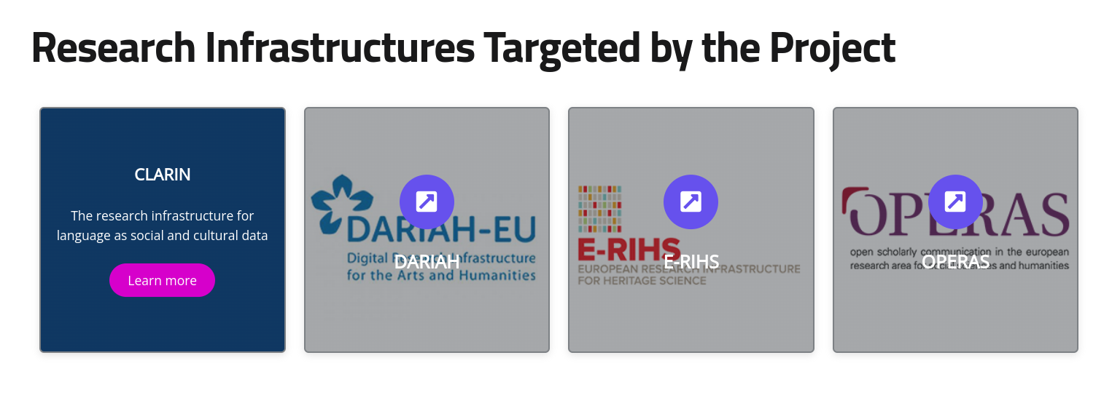
The H2IOSC project

Slide 8
CLARIN core services
Depositing services to make sure that language resources can be archived and made available to the community in a reliable manner and to help researchers to store their resources in a sustainable way
The Virtual Language Observatory provides an easy-to-use interface, allowing for a uniform search and discovery process for a large number of resources from a wide variety of domains.
The Federated Content Search is a search engine that connects to the local data collections that are available in the centres
The Language Resource Switchboard helps users to find a matching language processing web application for your data
The Virtual Collection Registry provides a registry where scholars can create and publish their virtual collections

Slide 9
How to access CLARIN services
All users can freely explore the CLARIN core services to search for language resources and expertise
Due to license restrictions, some resources are only available for academic users and login is required using your institutional credentials or CLARIN credentials
Academic users in all participating countries can access and use the language resources available in CLARIN data centers with a single sign-on access through the CLARIN Service Provider Federation using their institutional credentials

Slide 10
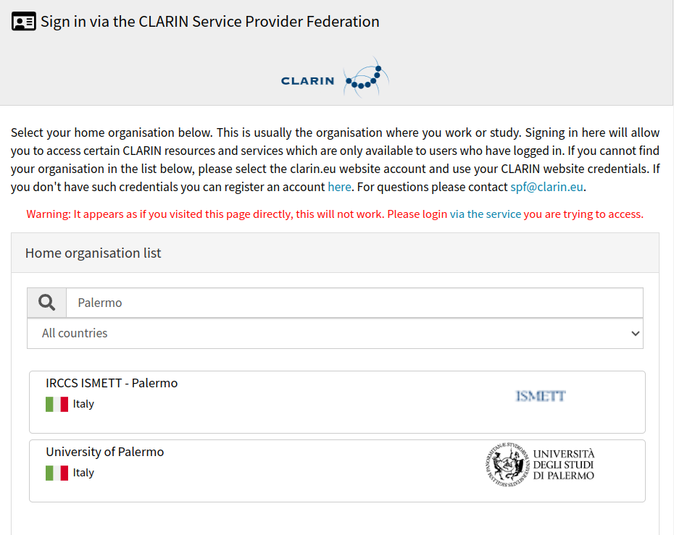
Sign in via the CLARIN Service Provider Federation

Slide 11
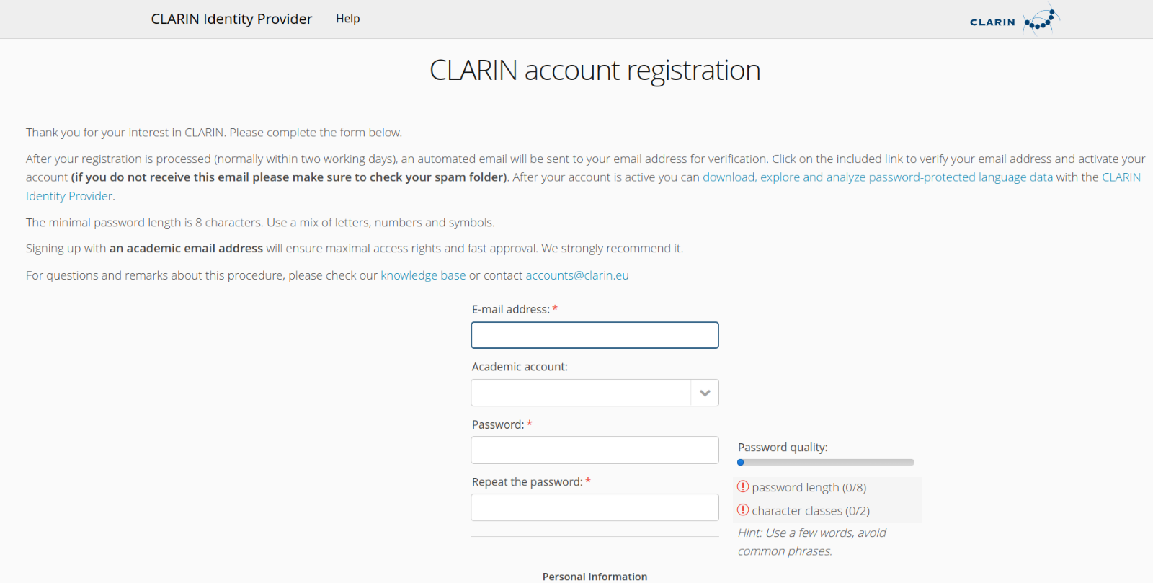
CLARIN account registration
If your university or institute is not in the list of federated organisations, you can request a CLARIN account

Slide 12
Depositing services
Many of the CLARIN centres offer a depositing service. They are willing to store the resources in their repository and assist with the technical and organisational details. This service ensures many advantages:
Long-term archiving: a storage guarantee can be given for a long period (up to 50 years)
Resources can be cited easily with a persistent identifier
The resources and their metadata will be integrated into the infrastructure, making it possible to search them efficiently
Password-protected resources can be made available via an institutional login
Once resources are integrated in the CLARIN infrastructure, they can be analysed and enriched more easily with various linguistic tools

Slide 13
The CLARIN Repositories
Ensure long-term preservation and curation of language resources, datasets and tools
Provide specific and specialised metadata to describe language resources
Assign Persistent Identifiers (PID), e.g. Handle, to the deposited resources, which enable easy citation
Offer advanced services to explore the language resources and their metadata, e.g. Virtual Language Observatory, Content Search, Switchboard tools, integrated corpus query engines (e.g. PML-TQ and Kontext)
Academic users can access restricted resources with their institutional credentials

Slide 14
How to use a repository: the example of ILC4CLARIN
ILC4CLARIN is CLARIN-IT B-centre hosted at Institute for Computational Linguistics, National Research Council, in Pisa. It offers depositing services for language datasets and tools for research, especially for Italian and classical languages via its repository
The ILC4CLARIN repository is a disciplinary repository certified by CoreTrust Seal and it offers advanced services to explore the language resources and their metadata (e.g. VLO, Switchboard ecc.)

Slide 15
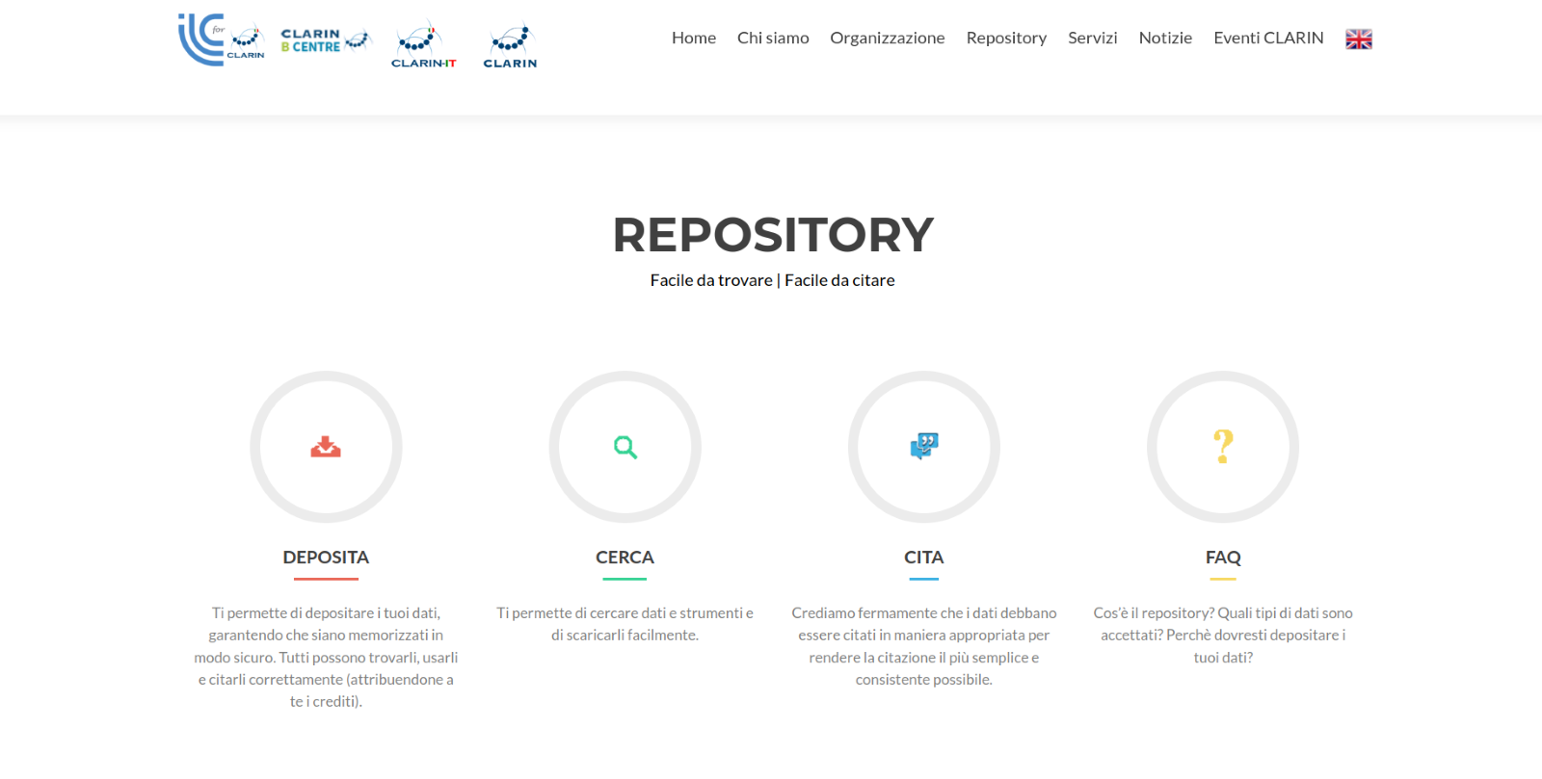
ILC4CLARIN repository: services

Slide 16
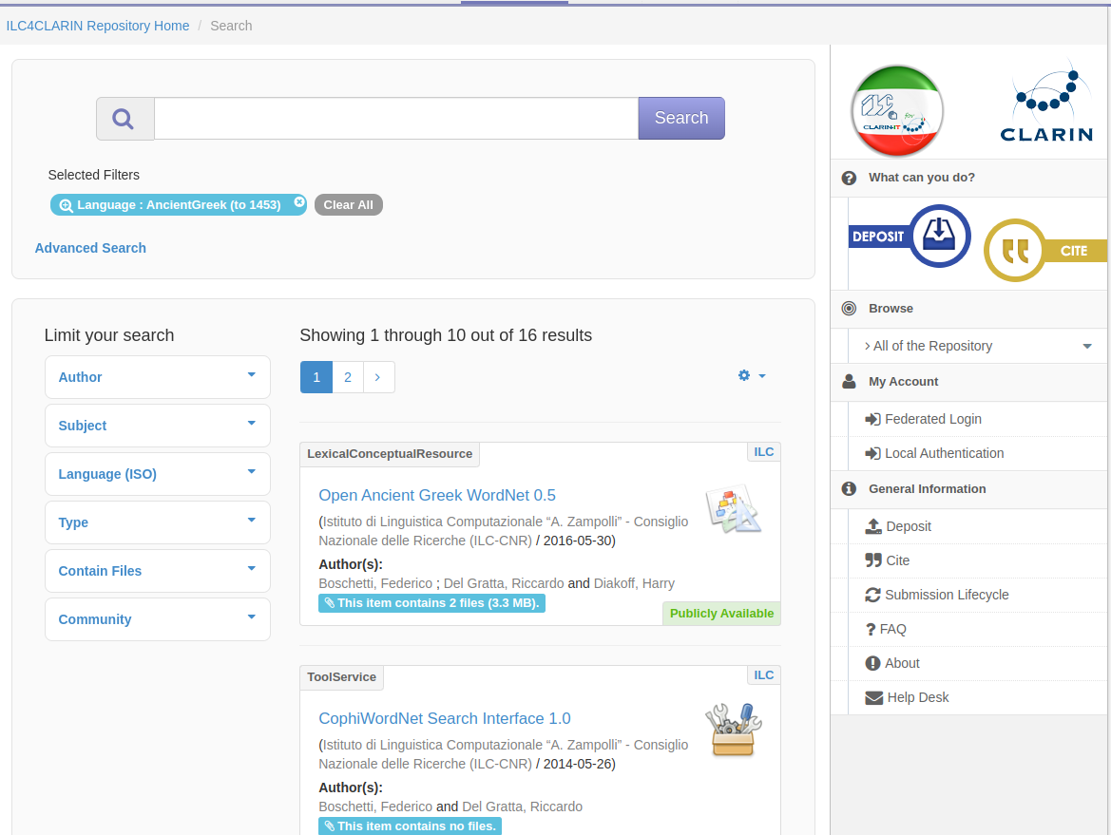
ILC4CLARIN language search: Ancient Greek

Slide 17
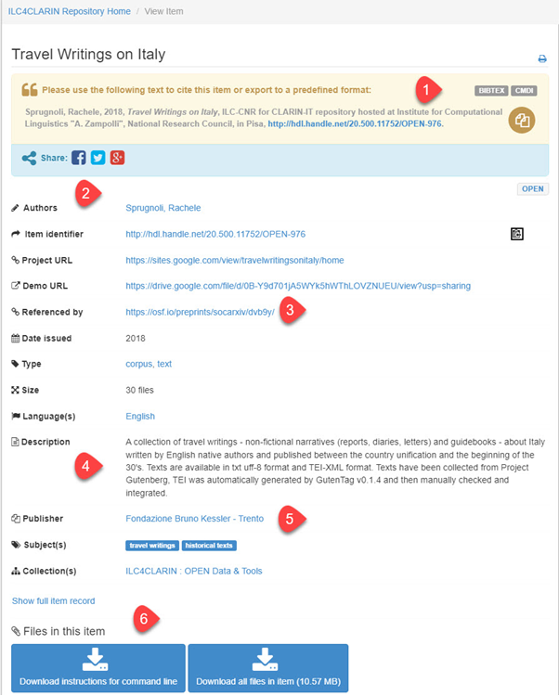
Example of a corpus in ILC4CLARIN Repository
Citation information via handle
Metadata fields describing the corpus
The corpus is referenced in a journal
The corpus is described, e.g. texts available in UTF-8 format and TEI-XML format
Publisher information
Download instructions
All the files can be

